Slide 1




HOTEL
AGGREGATOR
ANALYSIS
BY MARJORIE CALIMOSO

Slide 2



PROBLEM STATEMENT
This project aims to analyze a dataset of hotel aggregator listings using Power BI. The dataset comprises various attributes related to listings, hosts, reviews, and availability.

Slide 3





OBJECTIVES & GOALS
The objective is to create comprehensive visualizations and insights that shed light on trends, patterns, and factors influencing the performance of listings.
The goal is to explore key metrics such as pricing, availability, host characteristics, and review scores to derive actionable insights for improving the overall quality and competitiveness of the listings.

Slide 4

DATA INSIGHTS
1. GEOGRAPHICAL ANALYSIS
2. PRICING & AVAILABILITY
ANALYSIS
3. HOST PERFORMANCE
ANALYSIS
4. REVIEW SCORES & GUEST SATISFACTION
ANALYSIS
5. PROPERTY TYPE & ROOM
ANALYSIS

Slide 5
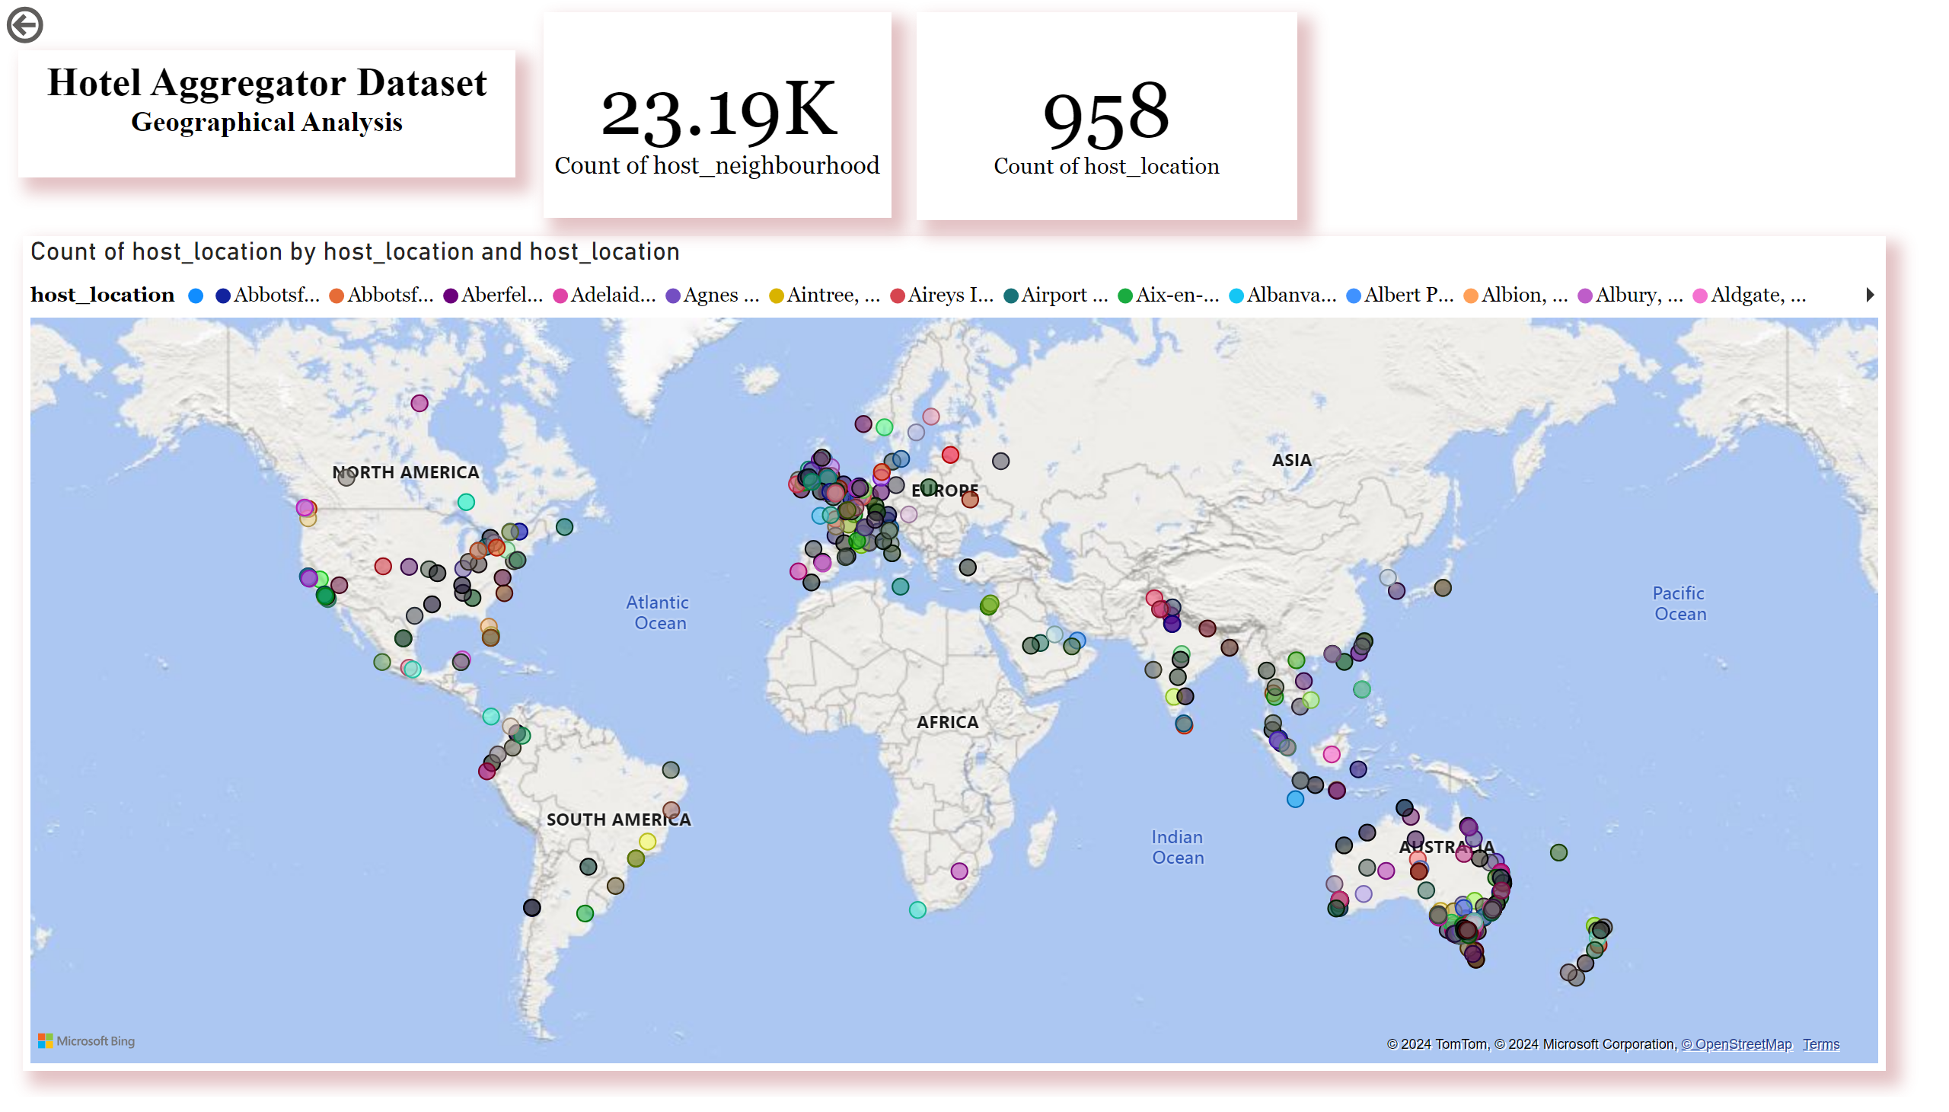
GEOGRAPHICAL ANALYSIS
In Geographical Analysis, the overall sum of host location is 958 in different continents in Europe, Australia, Asia, Africa, North America and South America and it also has 23, 019 for neighborhoods.
The aim of this dataset is to find the popular location where a lot of hosts is living and the result is in Europe.

Slide 6
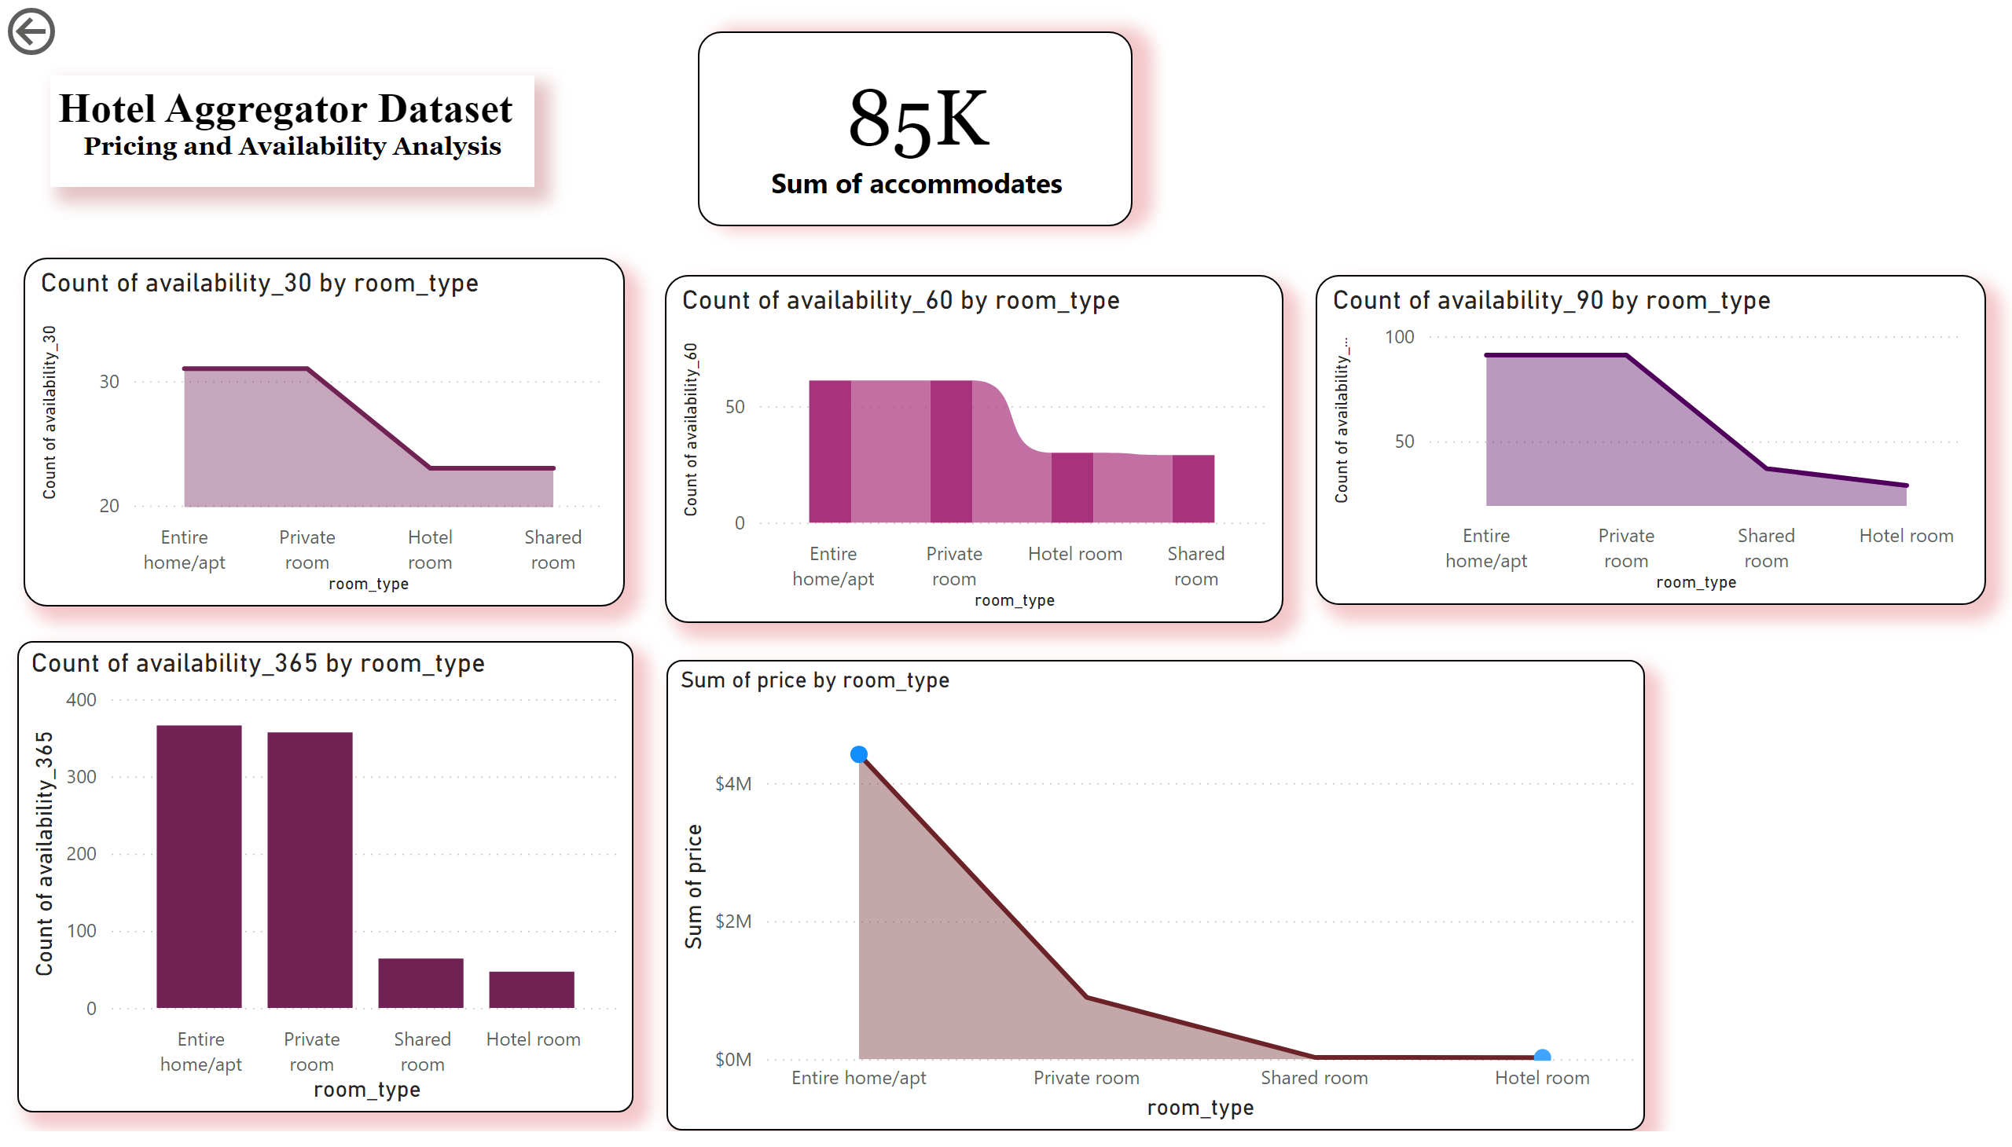
PRICING AND AVAILABILITY ANALYSIS
In Availability Analysis, as the dataset presented the entire home and private room has a high volume of availability while the hotel room and shared room has a lower availability. The sum of the persons they can accommodate is 85,000.
In Pricing Analysis, The entire home cost $4,417,801, the private room cost $894,126, the shared room cost $26,039 and the hotel room is $21,644.
The result states that the hotel room and shared room has a high volume of booking as day pass by because these two types of room has a lower cost than the other two types.

Slide 7
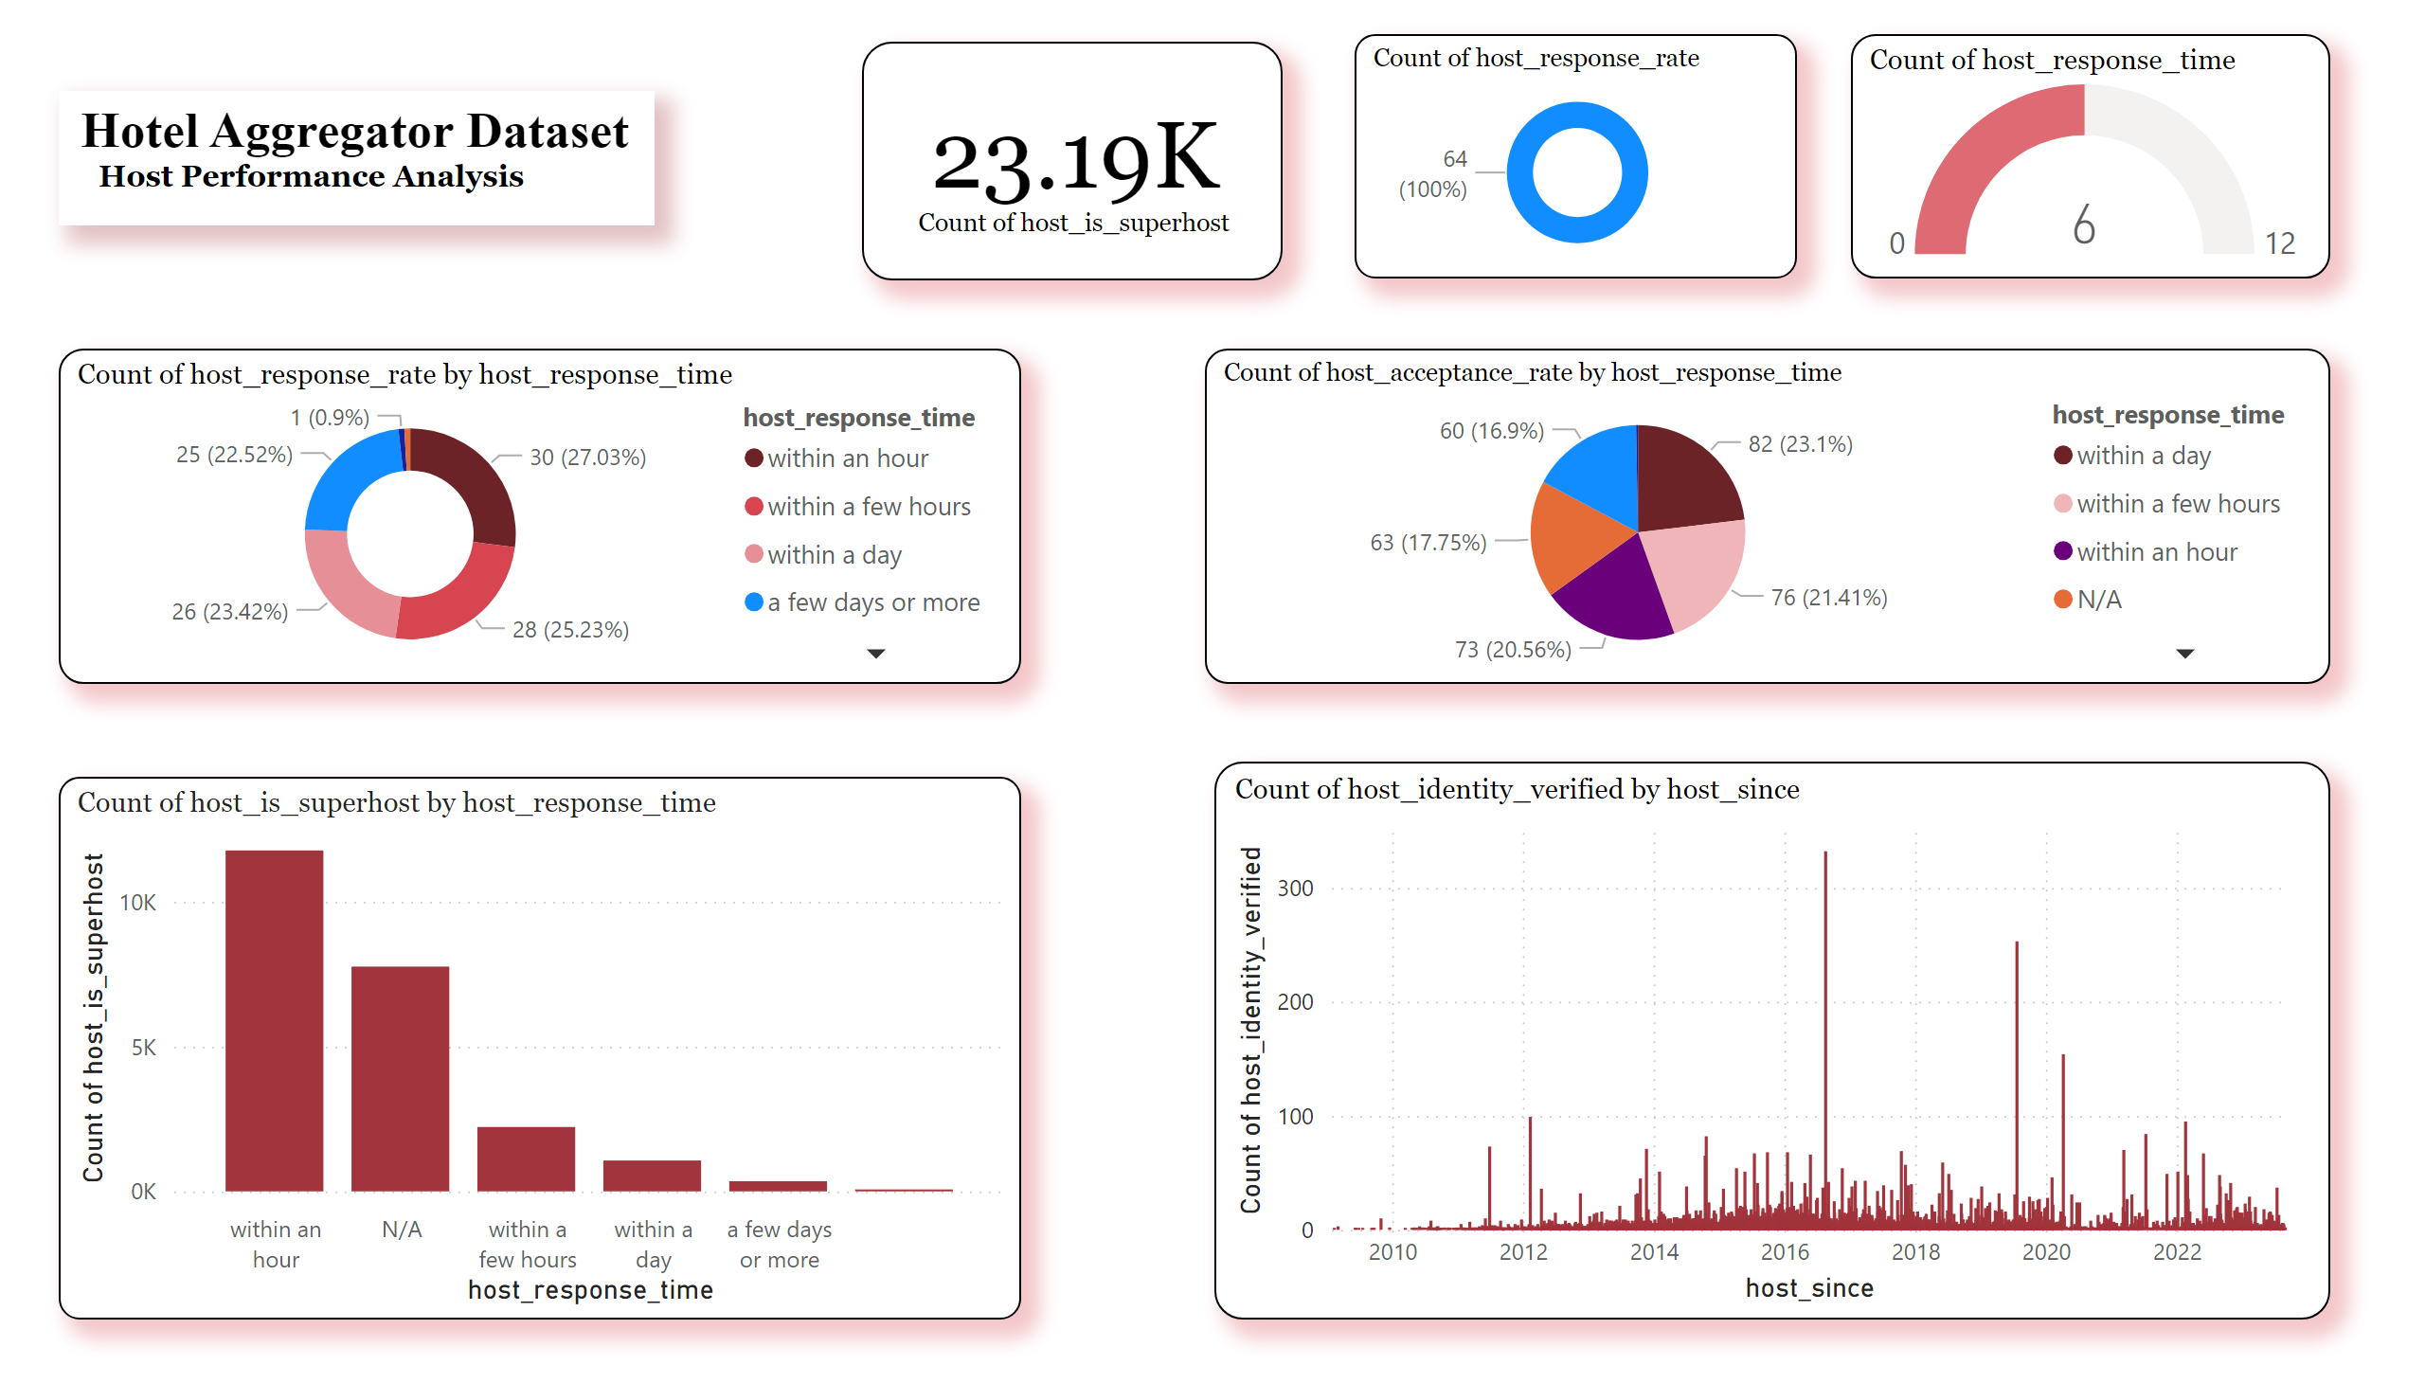
HOST PERFORMANCE ANALYSIS
In Host Performance Analysis, it has a 64% response rate from the host and the response time is 6/12 where in the performance of the host is a little bit slow
It also states that the count of host response by response time is within an hour, the acceptance rate by response time is within a day and sometimes within a few hours depending on how many customers are calling to reserve a room.
It also states here that the verified identity of the host is become lower that the previous years.

Slide 8
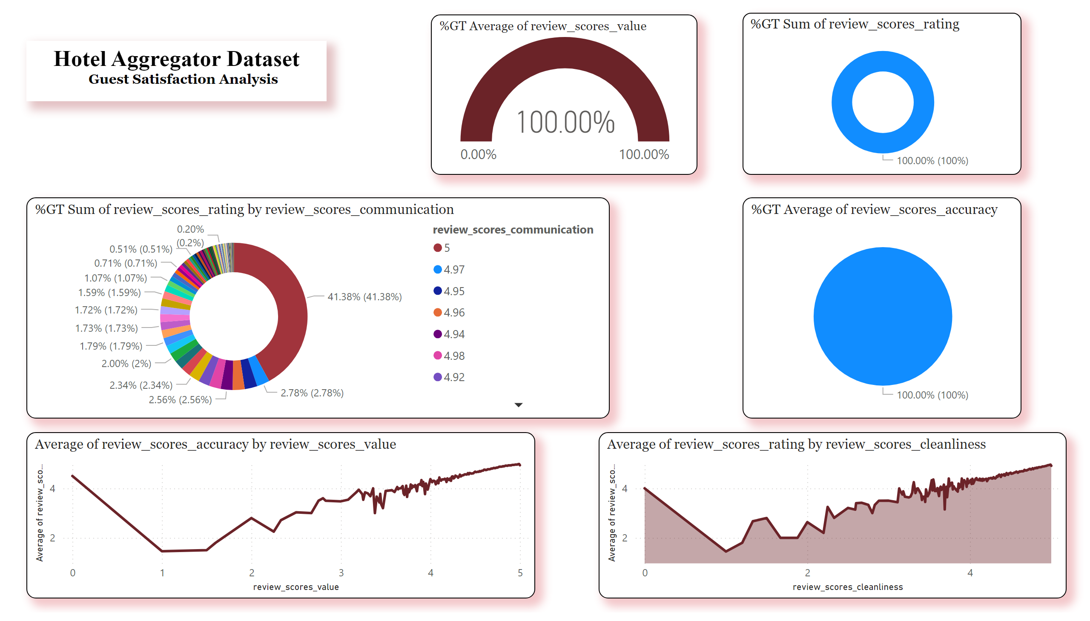
GUEST SATISFACTION ANALYSIS
In Guest Satisfaction Analysis, the overall review scores value the hosts got a rating of 100% from the customers same as the accuracy of the hosts it also have 100%.
When it comes to the communication skills of the hosts, the host which ID is 5 has a highest rating it has 41.38%

Slide 9
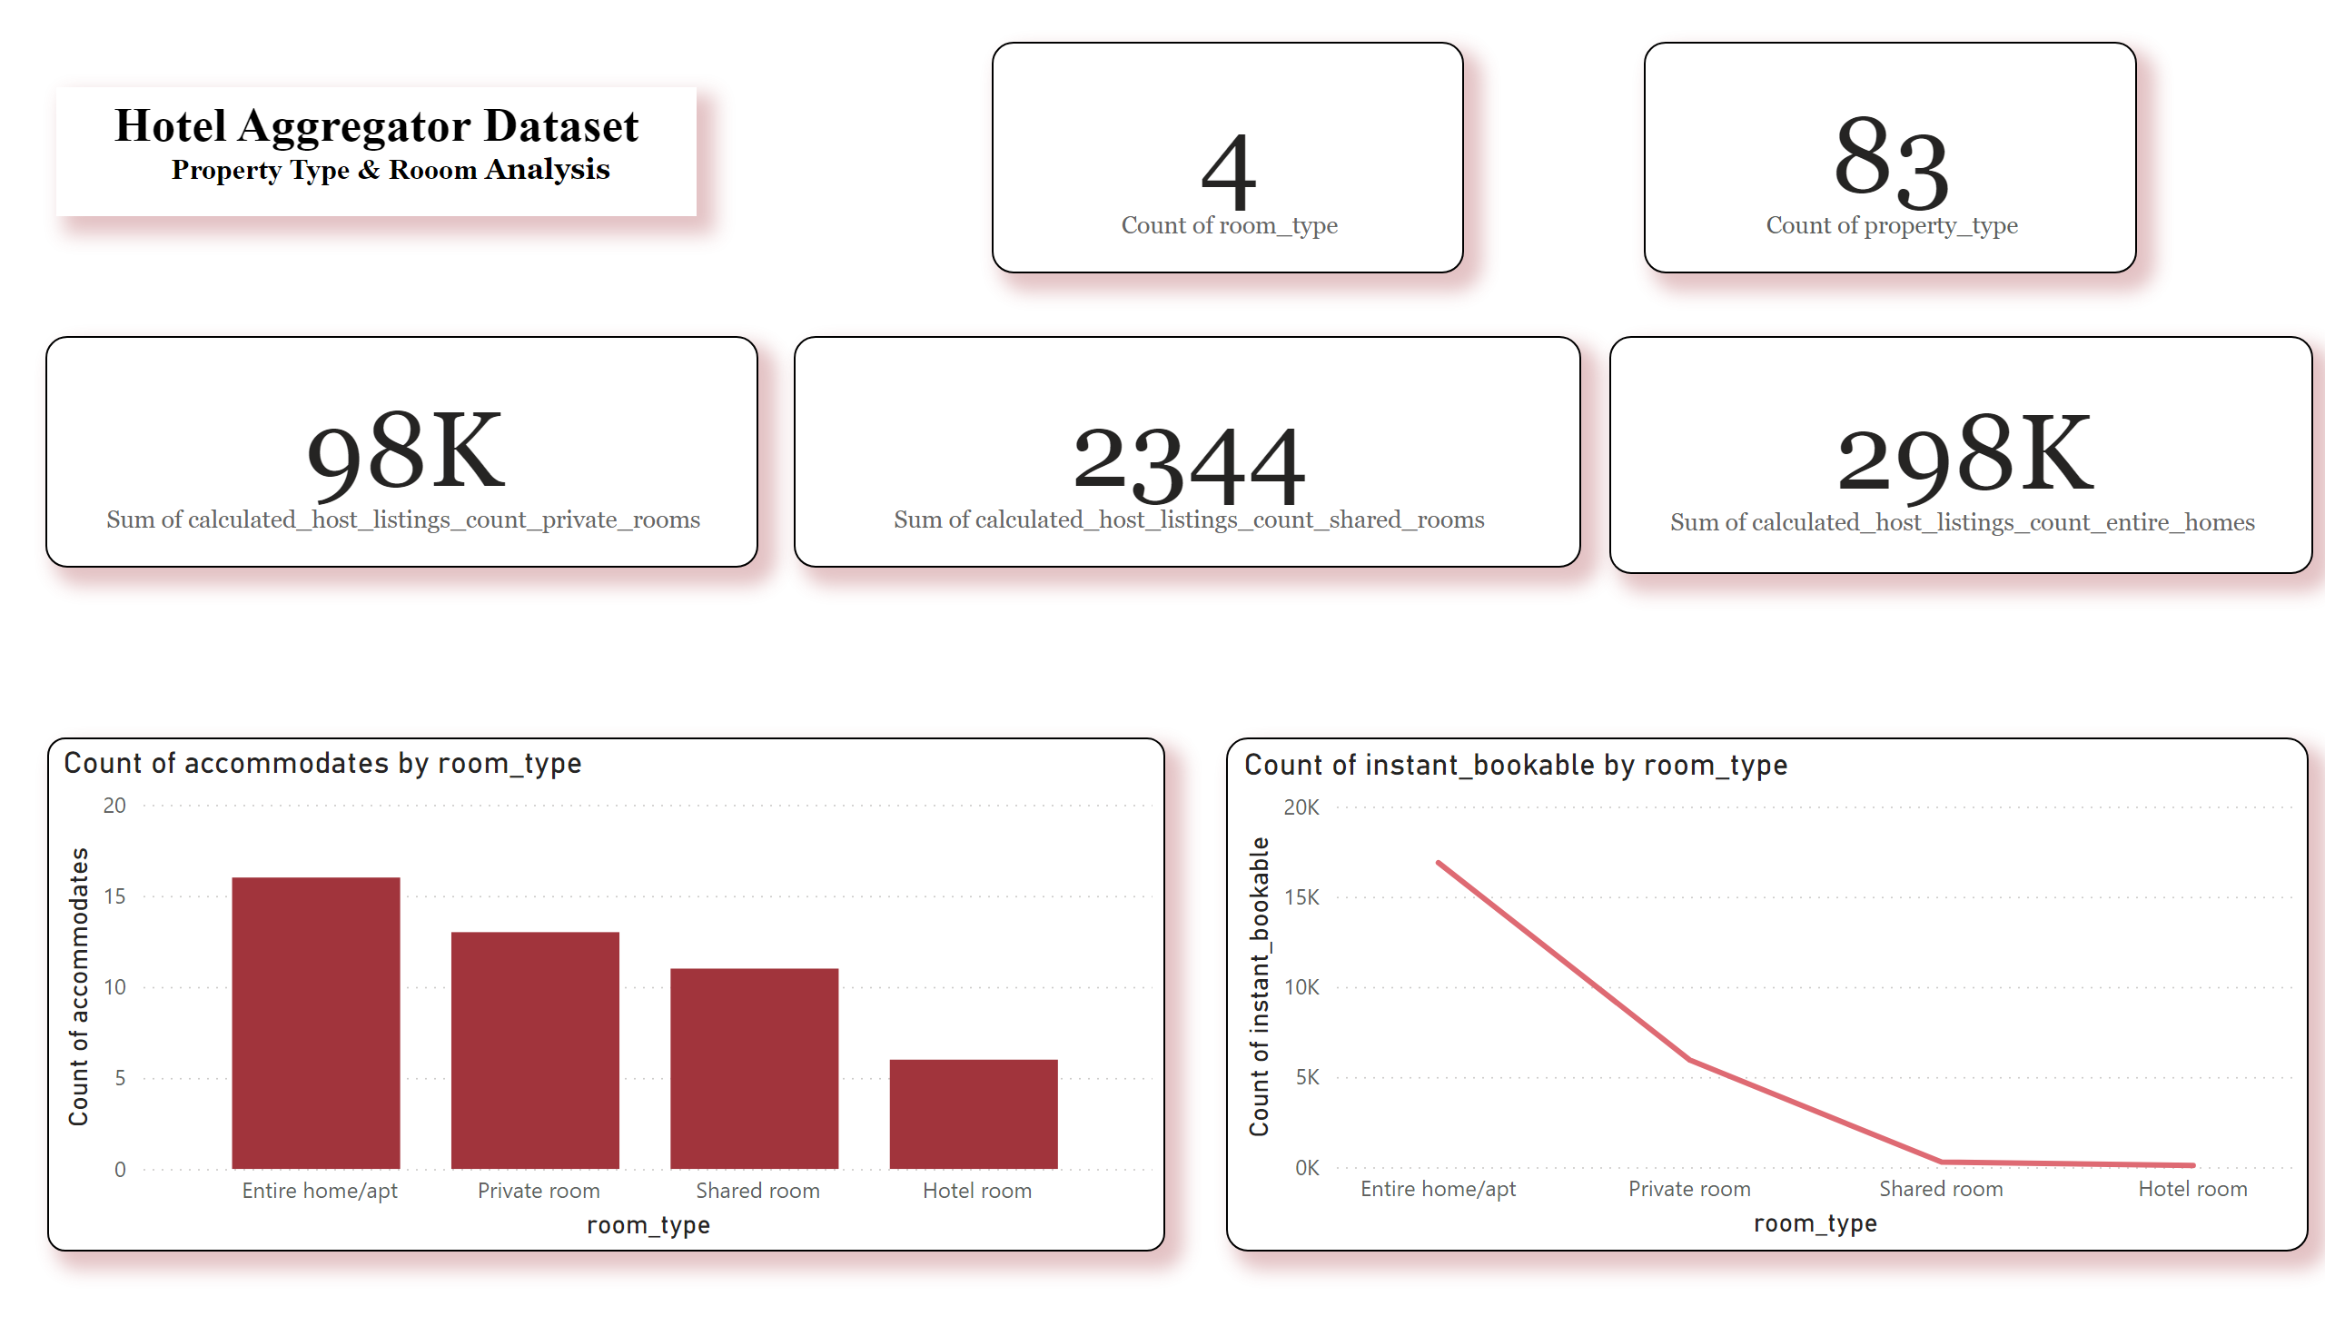
PROPERTY TYPE & ROOM ANALYSIS
In Room Type Analysis, it has a 4 types of room, it also has a 98,000 of private rooms, 2,344 shared rooms and entire homes has 298,000 and it also has an 83 property type.
The entire room can accommodate 16 persons, in private room it can accommodate 13 persons, in shared room it can accommodate 11 persons and the hotel room can accommodate 6 persons.
The count of instant bookable room type for entire home is 16, 887. In private room is 5,932. In shared room is 277 and in hotel room is 89.

Slide 10
Recommendations
Adapt and monitor market trends where they can promote the hotel services and packages like social media platform.
Enhance response time to the customers
Conduct a research to the customers on what the hotel will needs to be improve so that the hotel would know what the customer prefer.
Offer a discount package for the rush booking of customers. This strategy would attract bookings and minimize a cancellation of bookings.
Create a budget friendly packages
Tailor market trends to attract online bookings
Create a target promotions for each room type.

